Slide 1
Building Capacity
Math Breakout
January 2020
New York State Next Generation Math Standards
Notes:
What you can say: Welcome to the second part of our Phase II Building Capacity turnkey training. We are hopeful that by the end of the day you and your team will have more clarity on the process of supporting the standards. Now let us review where we have come so far.

Slide 2
Where is your district in the Building Capacity process, and will Math teachers be ready for implementation September 2020?
Notes:
Task: At your table on a scale of 1 - 3 write on a sticky note where your district is at this moment. (independently)
1 - Beginning the process of building capacity.
2 - Building capacity using the state guidelines and unpacking documents, but still need work on aligning instruction and assessment to our curriculum.
3 - Ready for Implementation
DO:
Share with your table members where you are, and what activities you have engaged in back in your districts.

Slide 3
LEARNING STANDARDS, CURRICULUM, INSTRUCTION, AND ASSESSMENT
14
Notes:
What you can say: Remembering where we have been since the beginning. We need to have a clear understanding of the differences between Standards, Curriculum, Instruction, and Assessment. When we first started Phase 1 Raising Awareness, we asked districts and educators to first represent the dynamic of how all four parts fit together. Are there any questions on how these differ?

Slide 4
PHASE II: BUILDING CAPACITY –
CURRICULUM/INSTRUCTION/ASSESSMENT ALIGNMENT
Provide professional development on the use of assessments (formative, as well as summative) and data driven instruction at the local level to encourage student growth and produce valid data.
Develop plans and resources to ensure that the instructional needs of Students with Disabilities and English Language Learners/Multilingual Learners will be met.
Notes:
You Could Say: Next we began looking at all the pieces one by one. This morning we discussed Assessment. Prior to that we discussed the standards, how to prioritize, and what the learning intentions of those standards were. Next we want to look at our current district curriculum materials and begin to align our resources with what the standards say. To get there we must look at both how the students are being assessed in the materials in comparison to how they are actually being assessed based on the language of the standards. What are the gaps? What are the obstacles? Will there be a need for supplemental materials? Is there emphasis on non-prioritized standards in the materials? What will this look like in our classrooms?

Slide 5
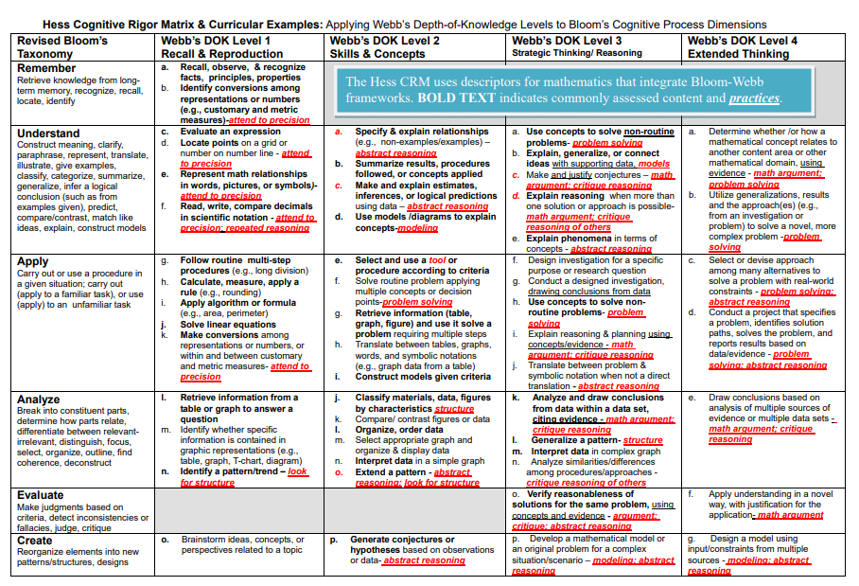
Hess Cognitive Rigor Matrix & Curricular examples
What is its purpose? (What content/skill is being assessed? Is there a right answer?)
What is the implied/intended rigor? (What mental processing would you expect students to engage in? Use the CRM to find descriptors.)
Which standards does it REALLY assess? (content + intended rigor)
Which practice standard helps with instruction to prepare for assessment
Does the scoring guide/rubric match content + intended rigor?
What would student responses tell a teacher if students could/could not do all or part of this task? (open-ended tasks, reasoning used) – next instructional decisions are clear
Notes:
You Could Say: Let us look at the Hess Matrix again. This time specifically for Math. Let us take a few minutes and match up where the standards intention is in the wording as compared to the Matrix.
You Could Say: Now let’s try to answer some of these questions as we are looking at our standards and our current materials. The bulk of our work will be here. As you see differences, make note of any changes that may have to be made to support the expectations of the standards.

Slide 6
Glossary of Verbs
Notes:
What you can say: Reminder that the Glossary will be a beneficial reference document to help with the understanding of the language of the standards and as guidance for the design of assessment questions.

Slide 7
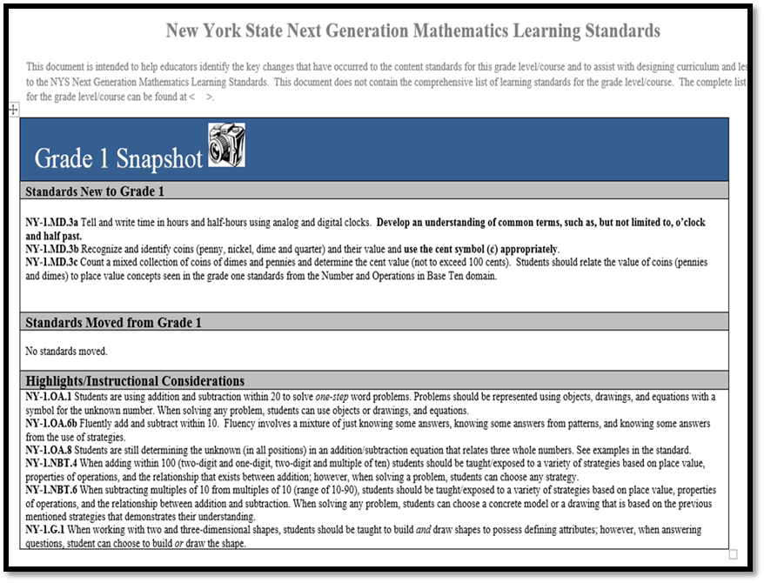
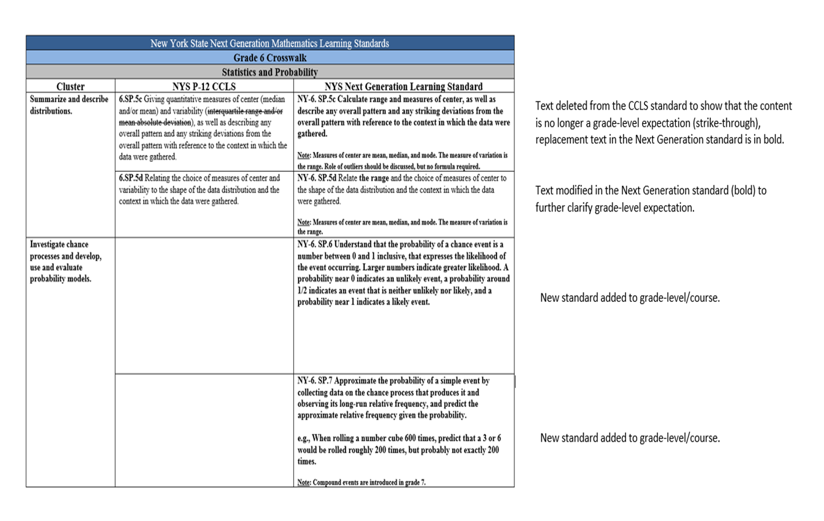
Building Capacity First Part: Have you and your colleagues…?
Notes:
You Could Say: Have you and your colleagues gone through all these documents first? Are you ready to begin breaking into your source materials to begin alignment? If this part of the process was skipped it will make the task of aligning materials that more challenging moving forward. If you have not done this part of the process, the suggestion is to stop and complete this first before moving forward.

Slide 8
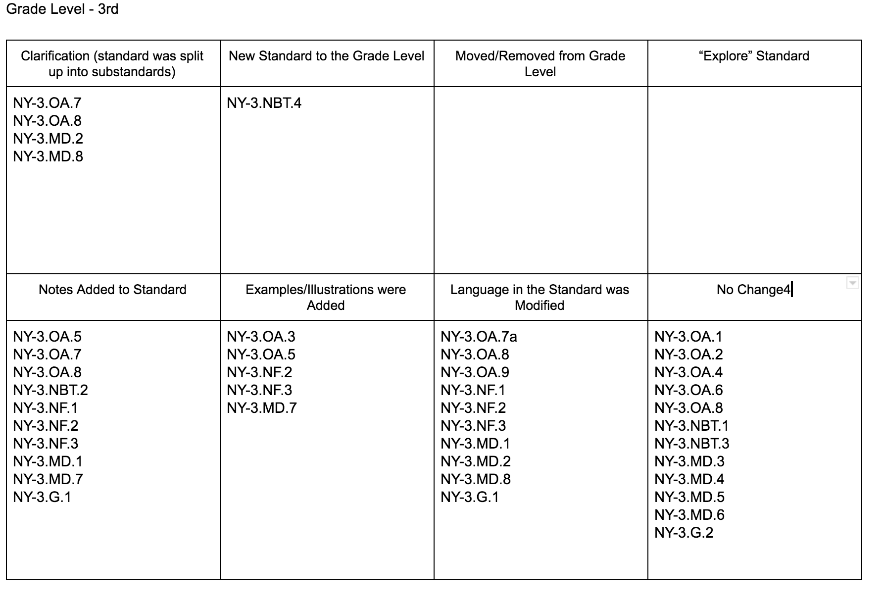
Crosswalk Analysis
Notes:
What you can say – During Phase I or at the beginning of Phase II you should have completed a Crosswalk Analysis to identify all the changes, and what type of changes happened in your grade level with the new standards.

Slide 9
Next Steps:
Use the snapshot highlights and instructional considerations section to determine some of the changes and what they mean.
I need to decide what changes I will make.
Use the Eureka Math Alignment document to find where the standard is located.
Notes:
What you can say - Once you have identified all your changes you need to start planning for the implementation and alignment of your district’s curriculum, instruction, and assessments.
Do: Click to advance each step as you explain.
The botto

Slide 10
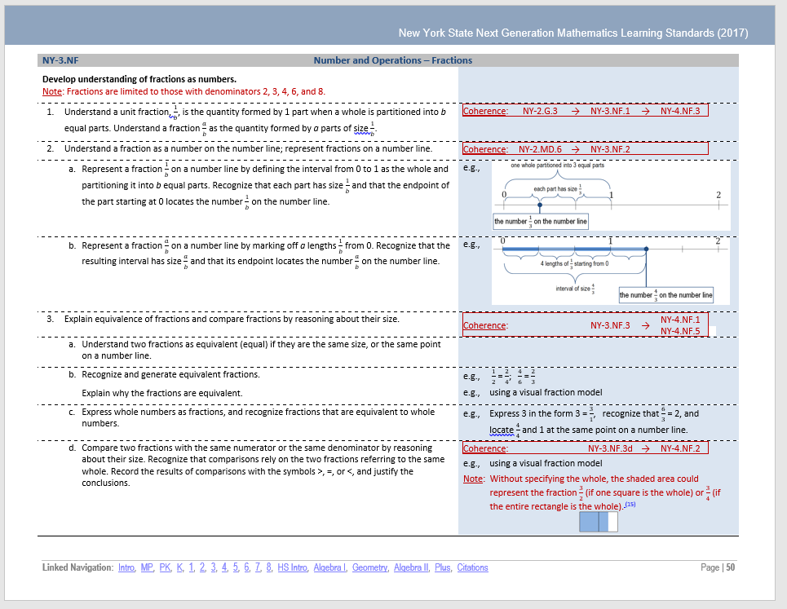
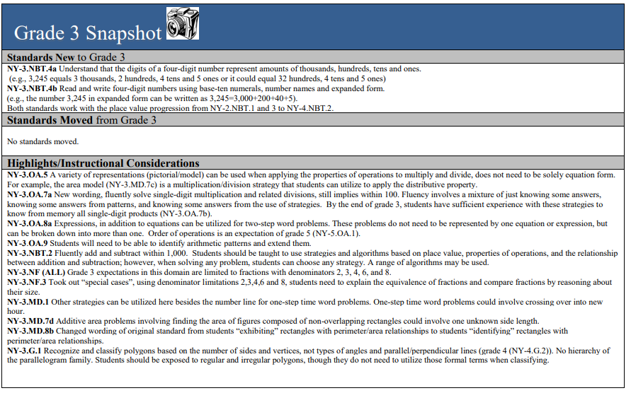
Change
Grade 3 Fraction Domain:
I notice a change was made to the entire domain in regards to denominator limits.
I check the Next generation Standards document and review notes and examples.
Notes:
You Could Say: Let’s look at this example. Here the language of the standard changed. Students are now expected to show “reason” for equivalence of fractions when comparing them. This would require more than just computation to show evidence. How will this change your instructional approach?

Slide 11
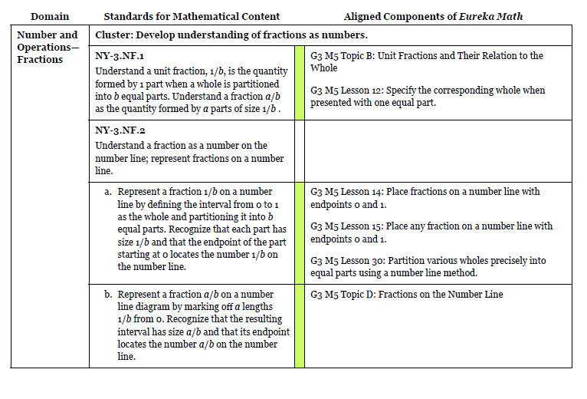
Change
Grade 3 Fraction Domain:
Locate NY-3.NF in the Eureka Alignment Document.
Find the Module, topic and lessons aligned to the standards
Notes:
You Could Say: Here is another example where the language has changed. Be mindful of that change moving forward. How will that student reach that standard based on the new language?

Slide 12
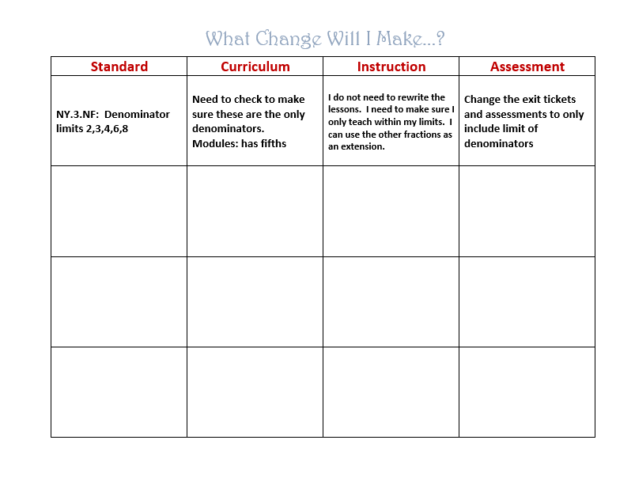
Notes:
You Could Say: Here is a useful tool created by our friends at MO BOCES. Taking your standard you are working on and make comparisons to the expectation/practices so your curriculum is using the correct language/symbols/examples. What change will you need to make to adjust and write that in under instructiona. Then looking at your assessment materials, what changes will you need to make there.
You Could Also Say: Here is where we will be spending a bulk of the time. Looking for those instructional gaps and envisioning how this will look in the classroom. What design changes need to be made? What adjustments do I need to tweek?

Slide 13
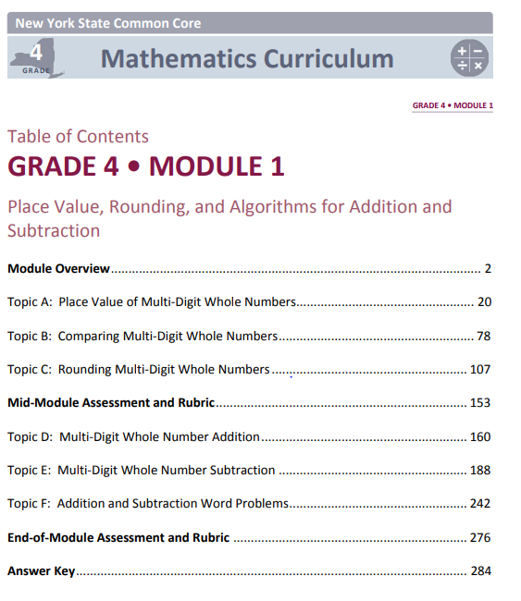
New Standards
Grade 3 NBT Domain:
Check the Snapshot
I check the Next generation Standards document and review notes and examples.
Locate NY-3.NBT.4 in the Eureka Alignment Document.
Find the Module, topic and lessons aligned to the standards
Notes:
What you can say – Now I will take you through the same process, but this time for a New Standard.
Do: Click through as you describe the steps for a new standard.
Check the top of the snapshot for any new standards added to your grade level. Her I see there are 2 new standards in Grade 3.
Next, I check the Next Generation Math Standards Document and review any notes and examples for the new standard.
I locate NY-3.NBT.4 in the Eureka Alignment Document, and I notice this time I see a blue bar. Remembering from the Key blue lets me know the standards are in the curriculum just at a different grade level.
I notice I will need to reference Grade 2 Module 3, and Grade 4 Module 1.

Slide 14
Need to check Grade 2 and Grade 4 for lessons
Find a place in Module 2 to logically insert lessons.
Add assessment questions to my benchmarks and exit tickets.
NY.3.NBT 4a
NY.3.NBT4b
Notes:
What you can say – Once again using the What Change Will I Make note catcher I document the standard in the first column. I reflect on what change if any will have to made to my curriculum. Depending on the curriculum you use you will determine if any lessons will have to be added or changed. If I use the modules as a sample, I noticed in the Eureka alignment document that it had me look in Grade 2 Module 3, and Grade 4 module 1 for some sample lessons. The next consideration I have to think about is my instruction. I need to find where in my pacing guide do I insert the new standards in a logical place. A great consideration at this point would be to unpack the new standard so I truly understand what my students need to be able to do and understand. It is very important to place the new learning with a logical progression in mind. Again using the example of the modules, this placement would happen in module 2. The last consideration is my assessments. The new third grade standards will be tested standards so I need to make sure I add some assessment questions that relate to the new standards.

Slide 15
Where can I find all those documents and more?
Our Madison –Oneida BOCES Toolkit!
www.moboces.org/buildingcapacity
Notes:
What you can say – All the documents we used today, and the copy of the power point will be accessible on our building capacity website by next week.

Slide 16
Moving Forward
Instructional Practices
Data Driven Instruction
Math PLC’s
Notes:
You can say - Moving forward and looking ahead at September 2020 when Phase III begins (Implementation). Here are a few topics to consider.
Instructional Practices. How do we better align our instruction to the Next Generation Math standards, and make sure we are providing equitable grade level instruction to ALL students.
How can we collect and use our Data to help drive our instruction
Lastly, There are 2 great ELA PLC’s that are currently running in our region. Let’s try to get some math PLC’s up and running so we can work on some of these goals together.

Slide 17
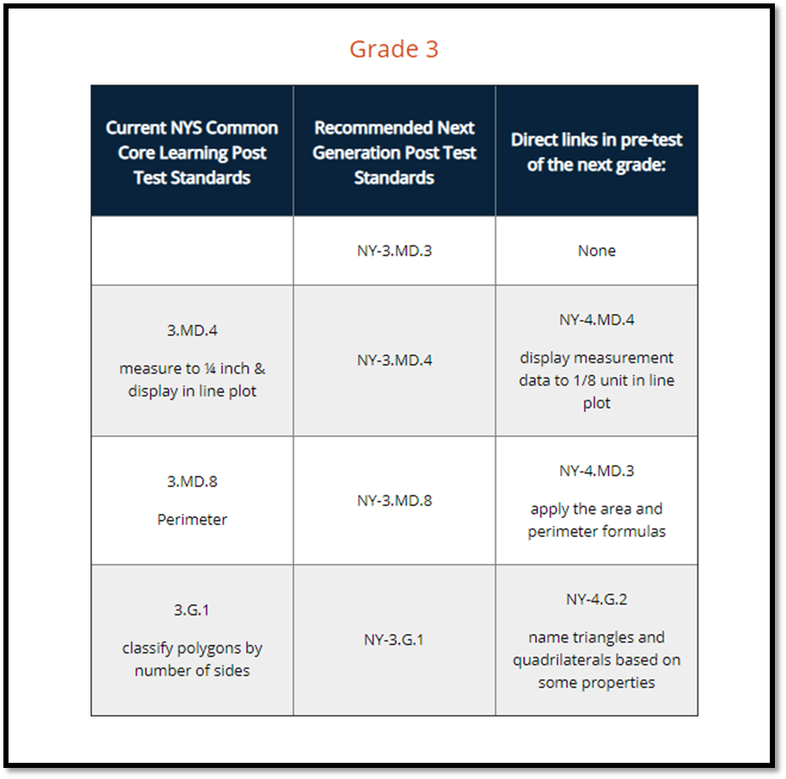
MATHEMATICS:
NEXT GENERATION STANDARDS IMPLEMENTATION
Examine Standards Document (Crosswalks and Snapshots): Scope and Breadth of Change
Next: Pre-Post Test Standards Designations can be found on the website and districts should plan accordingly.
Some highlights include the following:
Grade 3: Scaled pictograph/bar graph (NY-3.MD.3) (Additional)
Grade 5: Order of Operations Standards (NY-5.OA.1 and 2) (Additional)
Grade 6: All Probability and Statistics
Grade 7: Area and Circumference of a Circle (NY-7. G.4) (Additional)
Grade 8: Scientific Notation (NY-8.EE.3 and 4), Linear Systems of Equations (NY-8.EE.8)
Post-test content
(at teacher’s discretion) may be introduced at various points through out the year. Then, reinforced and built upon during the remaining months of school.
Notes:
What you can say - As we prepare for implementation in September 2020, and our first state assessment aligned to the Next Generation Math Standards, we need to be aware of the new pre-post test standards. Some highlights include:
Grade 3: Scaled pictograph/bar graph (NY-3.MD.3) (Additional)
Grade 5: Order of Operations Standards (NY-5.OA.1 and 2) (Additional)
Grade 6: All Probability and Statistics
Grade 7: Area and Circumference of a Circle (NY-7. G.4) (Additional)
Grade 8: Scientific Notation (NY-8.EE.3 and 4), Linear Systems of Equations (NY-8.EE.8)

Slide 18
MATHEMATICS: NEXT GENERATION STANDARDS IMPLEMENTATION SCAFFOLDING GUIDES (ELA AND MATH)
Guides use EngageNY module lessons to demonstrate the scaffolds, but the scaffolds are designed to be adaptable for locally designed lessons/curriculum.
Supporting All Students: Resource Guides for Scaffolding Instruction of English Language Arts and Mathematics
Notes:
What you can say - The Supporting All Students Resource Guides were designed through collaboration between the New York State Education Department and partners in the field. The purpose of these guides is to provide teachers with examples of scaffolds and strategies to supplement their instruction of English language arts (ELA) and mathematics curricula. The guides use the EngageNY mathematics modules as exemplars since they are free and open source curricula available for all New York State educators.
Scaffolds are instructional supports teachers intentionally build into their lesson planning to provide students support that is “just right” and “just in time.” Scaffolds do not differentiate lessons in such a way that students are working on or with different mathematical problems. Instead, scaffolds are put in place to allow all students access to grade-level content within a lesson. Scaffolds allow students to develop the knowledge, skills, and language needed to support their own performance in the future and are intended to be gradually removed as students independently master skills.
Do: Click on the link at the bottom of the page to show participants how to access the guides.
Currently, resource guides for Grades 3-5 Mathematics are available below. In Winter 2020, the resource guides for Grades 6-8 will be made available on this website.

Slide 19
MATHEMATICS:
NEXT GENERATION LEARNING STANDARDS IMPLEMENTATION
What is the unifying idea of the cluster? Does this unifying idea need to be modified based on standard changes that have occurred in the cluster/domain?
Grade-level Overviews
Has the standard been re-written to give a different emphasis or to be more inclusive?
Measurable and Observable statements that describe what success looks like when the learning goal is reached.
What foundational and supporting standards have been revised, moved or eliminated?
What will the effects be?
Notes and Clarifications
Coherence Links
Notes:
What you can say: At our last Building Capacity session, we demonstrated a process for unpacking the Next Generation Math Standards. I want to highlight here that during Phase III (Implementation) the unpacking process with continue. Unpacking the standards is a helpful task for teachers to engage in to help clear up any misconceptions of the meaning of the standards. This activity should continue through the final phase.
DO: Have participants take out the third grade unpacking document that is provided in their folder to look over as you review the different sections.

Slide 20
MATHEMATICS: NEXT GENERATION STANDARDS IMPLEMENTATION – SHARING OUR PROGRESS AND UPDATES
The NYS Next Generation Roadmap Spotlight http://www.nysed.gov/curriculum-instruction/nys-next-generation-roadmap- spotlight A platform for illuminating New York State’s progress as we journey through the implementation phases for the Next Generation Learning Standards “Educators, administrators, and leaders across New York State contribute articles with each other in mind, sharing their successes, challenges, and best practices related to the implementation of the revised standards.”
Updates from June 2019: Using surveys to identify professional development needs http://www.nysed.gov/curriculum-instruction/using-surveys-identify-professional-development-needs
Notes:
What you can say – The NYSED Curriculum and Instruction office has asked for articles to spotlight the implementation of the new standards. There is a link on the state website for districts to submit articles highlighting the work they have engaged in during Phase II. I wanted to take a minute to share a highlight from the VVS school district. VVS submitted an article on using surveys to identify professional development needs. The Oneida School District is working on a submission at this time also. I encourage all of you to highlight your work and efforts during this transition time.
Do: You can follow the link at the bottom of the page to show how to access the Roadmap Spotlight section, and follow the VVS link to their story.

Slide 21
Notes:
After watching clip say: I know this seems like a lot to tackle, but be patient. Remember productive struggle is good, but don’t let it turn into frustration. You’ve got this.

